Slide 1
Scalable Architecture
Scalable architecture is a system that can handle increased workloads without a significant drop in performance.
How to make a system scalable
Horizontal scaling: Add more machines or servers to distribute the workload across more units. This is also known as scaling out.
Vertical scaling: Add more resources, like CPU, memory, or storage, to a single server.
Micro-services architecture: Break down an application into smaller services, each responsible for a specific business capability.
Caching: Store frequently accessed data in memory to reduce the load on the server or database.
Load balancing: Distribute incoming network traffic across multiple servers or computing resources.
Modularity: Design systems as a collection of independent but interoperable modules.

Slide 2
Threads
Thread is the smallest unit of a process. One process is having number of threads.
A thread is having its own program counter, register set, thread id and a stack.
Single-threaded process: one thread executes all the sequence of operations.
Multi-threaded process: the joint effort of all threads will result in the execution of sequence of operations.
The meaning of quad-core (4 cores) and octa-core (8 cores) is that it can run 4 threads and 8 threads in parallel at a time respectively.
In parallelism the single time cycle is divided into small tiny time slots to run 100s of threads in a single time unit.
Parallel threads have a disadvantage that they shared same information resource so while one is using the data other remains ideal.
Scheduler is used to manage this issue.

Slide 3
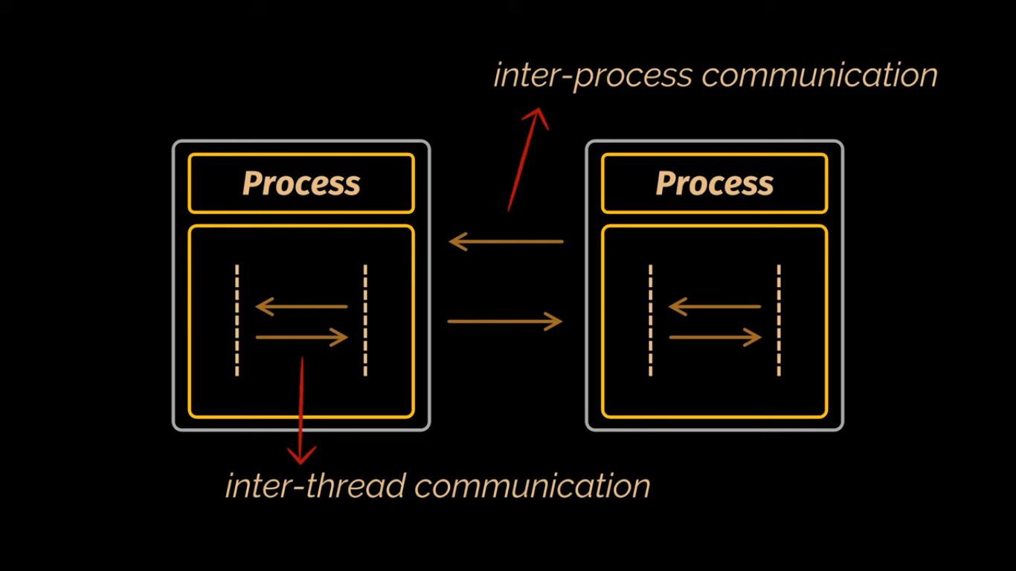

Slide 4
Process | Thread
Process means a program in execution. | Thread means a segment of a process.
A process takes more time to terminate. | A thread takes less time to terminate.
It takes more time for creation. | It takes less time for creation.
It also takes more time for context switching. | It takes less time for context switching.
A process is less efficient in terms of communication. | Thread is more efficient in terms of communication.
Multiprogramming holds the concepts of multi-process. | We don’t need multi programs in action for multiple threads because a single process consists of multiple threads.

Slide 5
Every process runs in its own memory. | Threads share memory.
A process is heavyweight compared to a thread. | A Thread is lightweight as each thread in a process shares code, data, and resources.
Process switching uses an interface in an operating system. | Thread switching may not require calling involvement of operating system.
If one process is blocked, then it will not affect the execution of other processes. | If a user-level thread is blocked, then all other user-level threads are blocked.
A process has its own Process Control Block, Stack, and Address Space. | Thread has Parents’ PCB, its own Thread Control Block, and Stack and common Address space.
Changes to the parent process do not affect child processes. | Since all threads of the same process share address space and other resources so any changes to the main thread may affect the behavior of the other threads of the process.
A process does not share data with each other. | Threads share data with each other.

Slide 6
Advantages of Process
Processes work independently in their own memory, ensuring no interference and better security.
Resources like CPU and memory are allocated effectively to optimize performance.
Processes can be prioritized to ensure important tasks get the resources they need.
Advantages of Thread
When there is a lot of computing and input/output (I/O) work, threads help tasks run at the same time, making the app faster.
Another advantage for having threads is that since they are lighter weight than processes, they are easier (i.e., faster) to create and destroy than processes.
Many apps need to handle different tasks at the same time. For example, a web browser can load a webpage, play a video, and let you scroll all at once. Threads make this possible by dividing these tasks into smaller parts that can run together.

Slide 7
Limitation of Single-threaded sequencing mechanism are as follows:
In order to exploit instruction-level parallelism, independent instructions from different-different basic building-blocks in a single instruction stream needed to be examined and issued together.
As the issue rate increases, a larger instruction buffer (for example -Reservation Station Entry) is needed to contain several basic building-blocks, which will be control dependency on different branch conditions, but their examination must be hit together.
Instruction-level analytical execution with branch prediction is also needed to move independent instructions across basic block boundaries. This problem is especially serious when a compiler attempts to pipeline a loop with many conditional branches.
the accuracy of systems is very low.
the speed of the system is quite low as compare to multithreaded architectures.

Slide 8
Multithreaded Architecture
Multithreaded architecture is a computing design where multiple threads execute independently but share the same process resources. This approach enhances system performance, responsiveness, and parallelism by allowing multiple tasks to run concurrently within a single application
Multithreading:
The ability of a CPU to manage multiple threads concurrently.
Improves CPU utilization by switching between tasks efficiently.
Types of Multithreading Models:
User-Level Threads (ULTs): Managed by user-space libraries without kernel involvement. ach user-level thread is a separate sequence of execution that runs within a single process. Multiple user-level threads can exist within the same process, and they share the same process resources, such as memory and file handles.
Eg. programming languages and libraries that support user-level threads include POSIX Threads (Pthreads) in C/C++, Java's green threads, and the Python threading module

Slide 9
Kernel-Level Threads (KLTs): Managed directly by the OS kernel.
Hybrid Model: A combination of ULT and KLT for balanced performance.
Advantages
Improved CPU utilization
Faster execution of parallel tasks
Better responsiveness in GUI applications
Efficient handling of multiple client requests (e.g., web servers)

Slide 10
Disadvantages:
Multiple threads can interfere with each other when sharing hardware resources such as caches or translation lookaside buffers (TLBs). As a result, execution times of a single thread are not improved and can be degraded, even when only one thread is executing, due to lower frequencies or additional pipeline stages that are necessary to accommodate thread-switching hardware.
Overall efficiency varies; Intel claims up to 30% improvement with its Hyper-Threading Technology, while a synthetic program just performing a loop of nonoptimized dependent floating-point operations actually gains a 100% speed improvement when run in parallel.

Slide 11
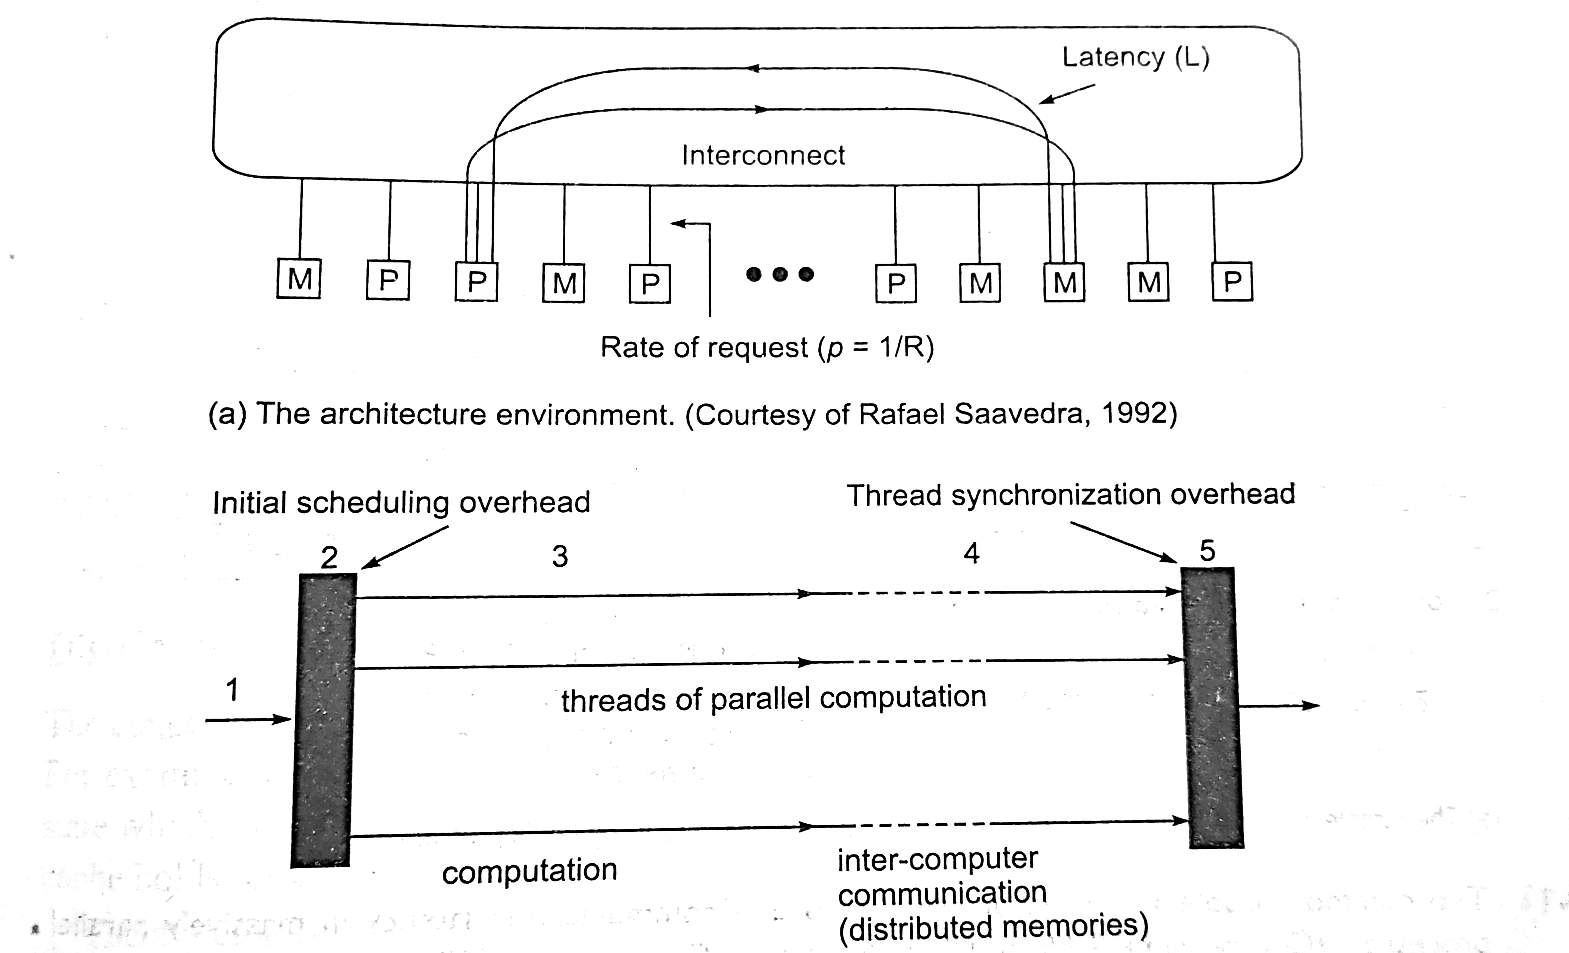
Multithreading (in detail)
Multithreaded processor is designed to handle multiple contexts simultaneously on context-switching basis.
One of the example of multithreaded processor is shown below having distributed memories and a network of processors.
Multithreaded computational model

Slide 12
The performance of this network can be analyzed using four parameters:
The computation starts with a sequential thread (shown as 1). Then the supervisory scheduling/scheduling overhead (2) where the processor begins threads of computation (3), the intercomputer messages that update variables among the nodes when the computer has a distributed memory (4), and finally the synchronization overhead (5) before beginning the next unit of parallel work.
Latency (L): it is the communication latency on a remote memory access. It includes the network delays, cache-miss penalty, and delays caused by contentions in split transactions.
Number of threads (N): the number of threads that can be interleaved in each processor.
Context-switching overhead (C): this refers to the cycles lost in performing context switching in a processor. It depends on the switch mechanism and the amount of processor states devoted to maintaining active threads.
Interval between switches (R): this refers to the cycles between switches triggered by remote reference. Its inverse p=1/R is called the rate of requests for remote access. This reflects the combination of program behaviour and memory system design.

Slide 13
General features of multithreaded architecture
In its regular form, a multithreaded processor is made up of many numbers of thread processing elements that are connected to each other with a unidirectional ring which helps in performing the system in a better way.
All the multiple thread processing elements have their own private level-one instruction cache, but they’ll share the level-one data cache and the level-two cache.
In the multithreaded systems also some shared register files present that used for maintaining some global registers and a lock register.
During run-time, the multiple thread processing elements, each has its own program counter and instruction execution path, which can then easily fetch and execute instructions from multiple program locations simultaneously.

Slide 14
The real execution of a program initiates from its entry thread. This entry thread can then transfers the systems’ processing to a successor thread on some another thread processing element. The successor thread can further transfer the systems’ processing to its own successor thread. This process will continue until all thread processing elements are busy with some appropriate tasks.
When the multiple threads are executed on the multithreaded processor, the primeval thread in the sequential order is referred to as the head thread. And then all of the other threads which are derived from it are called successor threads. Once the head thread completes its computation, then further it will retire and release the thread processing element and then its (just) successor thread then becomes the new head thread. This completion and retirement of the threads must have to follow the original sequential execution order.

Slide 15
In the multithreaded system (or model), a thread can transfer the systems’ processing one of its successor threads with or without control speculation. When the transfer of the systems’ processing from head to its successor thread without control speculation, the thread performing the fork operation must ensure that all of the control dependencies of the newly generated successor thread have been satisfied.
If the transfer of the systems’ processing from the head to its successor thread with control speculation, however, it must be later on verifying all of the speculated control dependencies. If any of the speculated control dependencies are not true, the thread must have to issue a command to kill the successor thread and all of its subsequent threads.
In general, the multithreaded architecture will use a thread pipelining execution model in order to enforce data dependencies between concurrent threads. Unlike the instruction pipelining mechanism in a superscalar processor, where instruction sequencing, data dependencies checking, and forwarding are performed by processor hardware automatically, the multithreaded architecture performs thread initiation and data forwarding through explicit thread management and communication instructions.

Slide 16
Types of multithreading
Coarse grained/block co-operative multithreading: The simplest type of multithreading occurs when one thread runs until it is blocked by an event that normally would create a long-latency stall. Such a stall might be a cache miss that has to access off-chip memory, which might take hundreds of CPU cycles for the data to return. Instead of waiting for the stall to resolve, a threaded processor would switch execution to another thread that was ready to run. Only when the data for the previous thread had arrived, would the previous thread be placed back on the list of ready-to-run threads.
For example:
1. Cycle i: instruction j from thread A is issued.
2. Cycle i + 1: instruction j + 1 from thread A is issued.
3. Cycle i + 2: instruction j + 2 from thread A is issued, which is a load instruction that misses in all caches.
4. Cycle i + 3: thread scheduler invoked, switches to thread B.
5. Cycle i + 4: instruction k from thread B is issued.
6. Cycle i + 5: instruction k + 1 from thread B is issued.

Slide 17
2. Interleaved multithreading: The purpose of interleaved multithreading is to remove all data dependency stalls from the execution pipeline. Since one thread is relatively independent from other threads, there is less chance of one instruction in one pipelining stage needing an output from an older instruction in the pipeline.
For example:
1. Cycle i + 1: an instruction from thread B is issued.
2. Cycle i + 2: an instruction from thread C is issued.
3. Simultaneous multithreading: The most advanced type of multithreading applies to superscalar processors.
A normal superscalar processor issues multiple instructions from a single thread every CPU cycle, in simultaneous multithreading (SMT) a superscalar processor can issue instructions from multiple threads every CPU cycle. Recognizing that any single thread has a limited amount of instruction-level parallelism, this type of multithreading tries to exploit parallelism available across multiple threads to decrease the waste associated with unused issue slots.

Slide 18
For example:
1. Cycle i: instructions j and j + 1 from thread A and instruction k from thread B are simultaneously issued.
2. Cycle i + 1: instruction j + 2 from thread A, instruction k + 1 from thread B, and instruction m from thread C are all simultaneously issued.
3. Cycle i + 2: instruction j + 3 from thread A and instructions m + 1 and m + 2 from thread C are all simultaneously issued.

Slide 19
Data flow computers
Dataflow computers have the potential for exploiting all the parallelism available in a program.
The execution is driven only by the availability of operands so there is no need for a program counter in this architecture.
Although the dataflow concept offers the potential of high performance, but the performance may be restricted due to limited number of functional units, limited memory bandwidth and the need to associatively match the pending operations with available functional units.

Slide 20
Data flow Architecture
Dataflow architecture is a computer architecture that depicts how data moves through a system.
In this approach, the data enters into the system and then flows through the modules one at a time until they are assigned to some final destination (output or a data store).
The connections between the components or modules may be implemented as I/O stream, I/O buffers, piped, or other types of connections.
The data can be flown in the graph topology with cycles, in a linear structure without cycles, or in a tree type structure.
Data flow graphs specify only a partial order for the execution of instructions and thus provide opportunities for parallel and pipelined execution at the level of individual instruction.

Slide 21
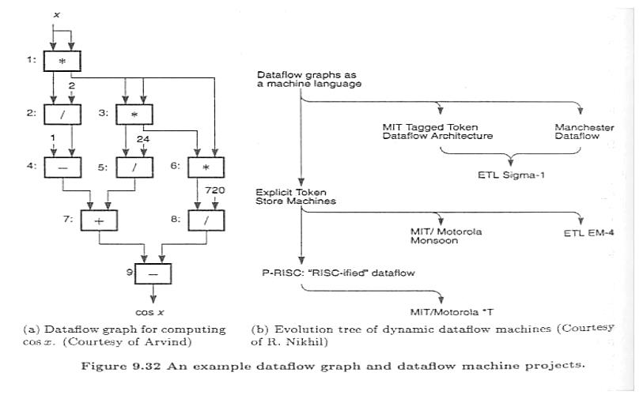
Data Flow Graph

Slide 22


The graph in fig. (a) shows how to obtain an approximation of cosx by the power series computation:
The corresponding data flow graph consists of nine operators. The edges in the graph interconnect the operator nodes. Successive powers of x are obtained by repeated multiplications and divisors are fed into node directly.

Slide 23
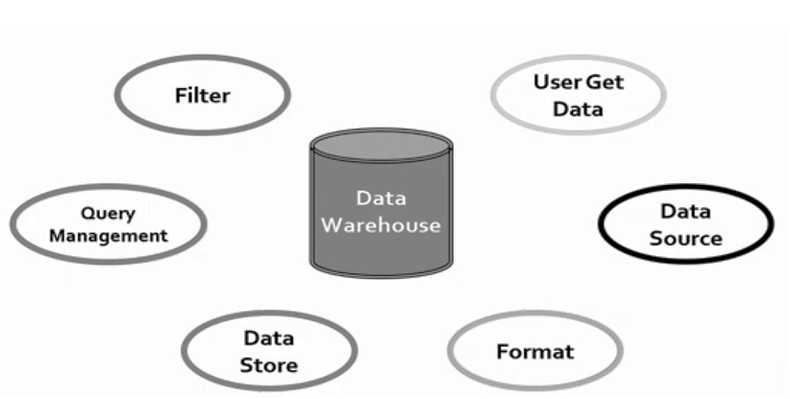
Data Flow Architecture

Slide 24
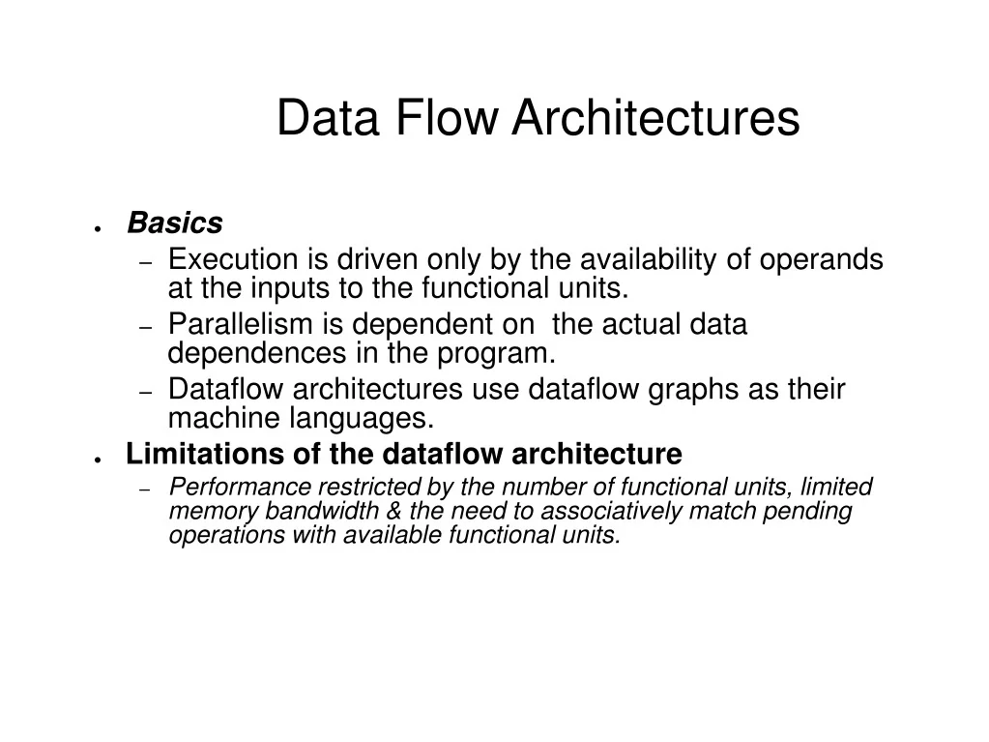

Slide 25
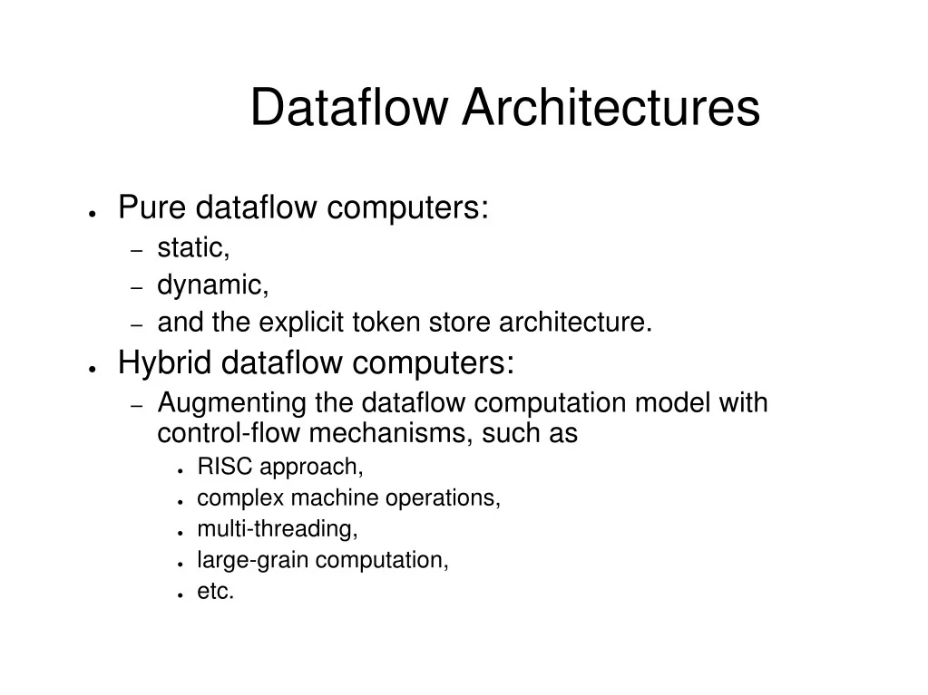

Slide 26
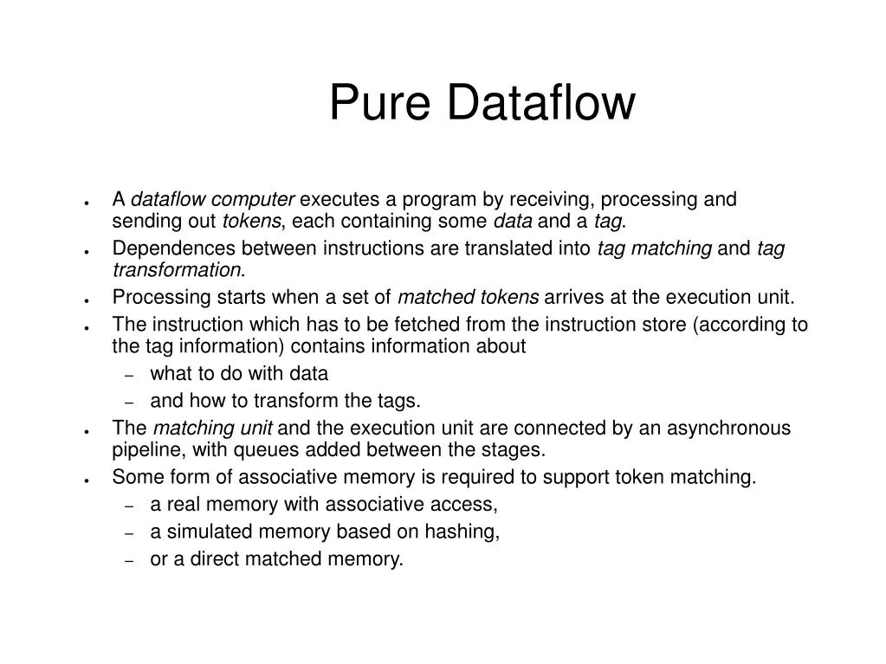

Slide 27
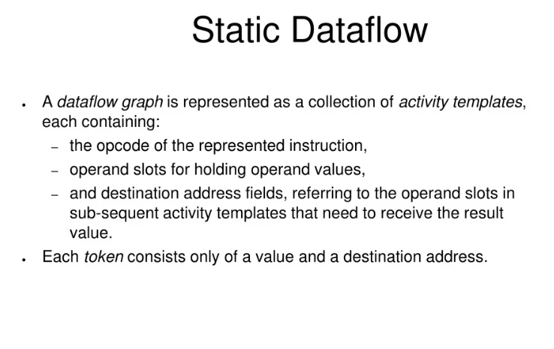

Slide 28
